Slide 1
OBJECT DETECTION IN POINT CLOUD - POLE
NITAL MILIND BANSODE (A20427196)
ABHISHEK KRISHNA VANDADI (A20426749)
AMITDEB PRASAD BHATTACHARYA (A20402789)
KARTHIK CHANNARAYAPATNA MAHESH (A20383027)

Slide 2
OBJECTIVE
The aim of this project is to develop a pole detection algorithm to detect poles in an image. The output we generate will be in the form of a 3d graph.

Slide 3
Why Do We Need Pole Detection Algorithms?
If we can detect poles, we can create maps with even better accuracy which would help the users.
Furthermore, it will be very helpful to work on accident-avoidance strategies.
Moreover, we can easily get to know the position of the poles which would be very helpful during any man-made or natural disasters as the poles get dislodged by the force.

Slide 4
CONTD….
Accurate pole detection algorithms also improve the efficiency of automated driving as poles can be easily avoided.
Many other advantages include better understanding of roads, development of mishap detection applications etc.

Slide 5
Input and Output
Input: final_project_point_cloud.fuse
Output: A 3D Graph image with poles detected in the form of straight line segments.

Slide 6
Language used
Python

Slide 7
Packages Needed For Execution:
Point Cloud Library(also known as PCL)
Numpy
MatPlotLib
Mpl_toolkits
geo2cart

Slide 8
Our Approach:
Step 1: Convert the given points into x, y and z co-ordinates using cartesian logic. The x, y and z co-ordinates represent latitude, longitude and altitude.
Step 2: We use the statistical outlier filter from PCL to remove outliers. All the data points which are not around threshold are removed. In this method, mean distance is computed for each point from it to all it’s neighbours. A guassian distribution is formed with the mean and standard deviation. All the distances whose distances are not in the range between the two parameters are outliers and are removed.
Step 3: The rest of all the points are returned.

Slide 9
CONTD…
Step 4: We use KDTree to detect the large components in an image like cars. This removal procedure will make the image look clearer and better. As we can see the code, make_kdtree_flann() method is a generic type of 3D spatial locator using kd-tree structures [2]. On the other hand, nearest_k_search_for_cloud() is used to find points which are close and compute the mean distances between them.
Step 5: Cylindrical and Plane Segmentation is performed on the refined values after outlier and component removal. Cylindrical segmentation isolates cylindrical objects. On the other hand, Plane segmentation isolated plane objects. The image in the next slide is obtained after the completion of these steps.

Slide 10
Output Images:
The output image is a 3D image which can be tilted in any direction. The green straight lines represent the poles.
Next three are the images of output with different angles in next slides.

Slide 11
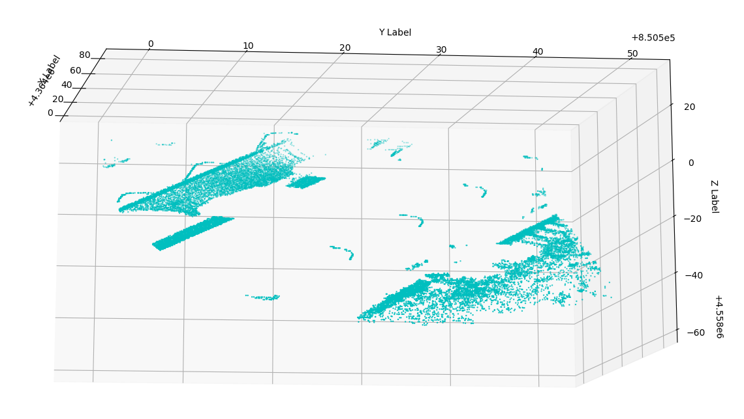

Slide 12
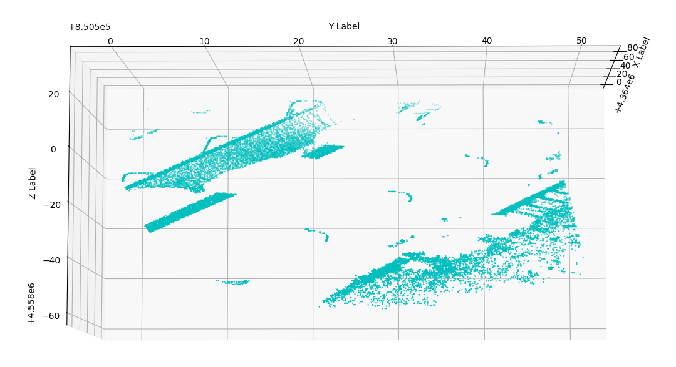

Slide 13
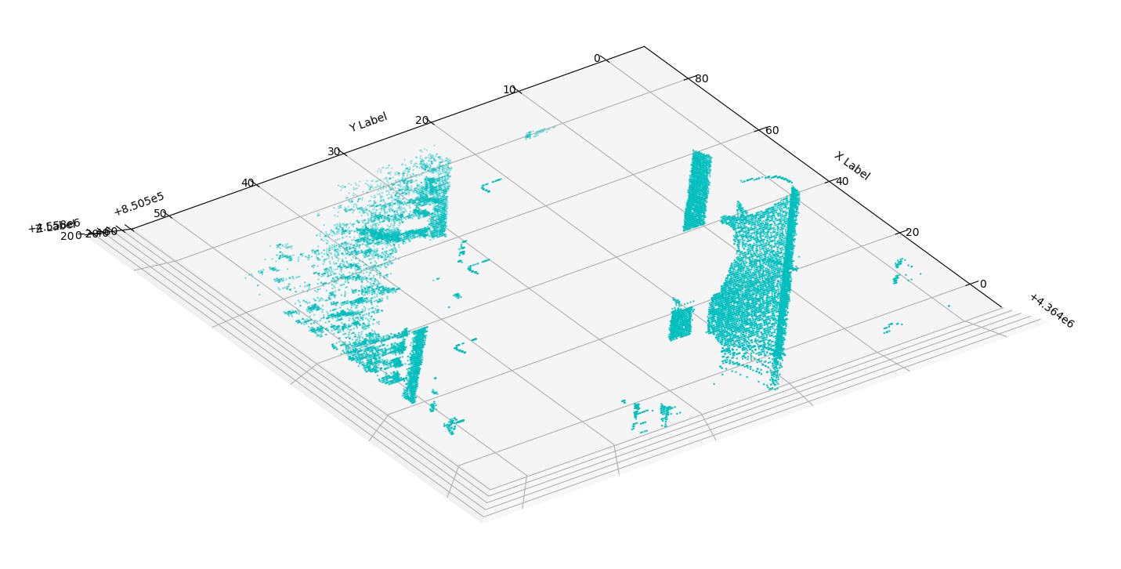

Slide 14
References
[1] http://pointclouds.org/documentation/tutorials/using_pcl_pcl_config.php)
[2] http://docs.pointclouds.org/1.0.1/classpcl_1_1_kd_tree_f_l_a_n_n.html#_details
[3] http://pointclouds.org/documentation/tutorials/cylinder_segmentation.php

